Slide 1
Advanced
Architrino
Assemblies

Slide 2
Fermion Geometry Animation : Noether Core Nested Tri-binary + Six Weak Personality Potentials in the Poles
?
?
?
+
+
−
+
−
−
?
?
J Mark Morris
?

Slide 3
The Electron Geometry : Noether Core Nested Tri-binary + Six Weak Personality Potentials in the Poles
−
−
−
+
+
−
+
−
−
−
−
J Mark Morris
−

Slide 4
Mapping the Gluon
It appears that Quantum theory defines the gluon as the coupled flux tubes — but does not include the energetic binaries that generate the potential vortices. The potential vortices cause action on the source binaries as well as any captive personality potentials.
+
−
+
Orbiting binary
Provenance of W and Z boson reactions indicates that personality point potentials may be swapped in coupled vortices
−
J Mark Morris

Slide 5
Architectural Exploded View for a Nested Fermion
Generation I binary assembly - Exploded view
Presumably l >> r?
Generation II binary assembly with explosion view from center of Generation I
Generation III binary assembly with explosion view from center of Generation II
Everything is shown in 2D. In reality, the binaries are spinning at different frequencies but possibly harmonically. The polar point potentials are vibrating.
Each binary pole can strongly couple.
Personality potentials bind in the poles.
The nested assembly shields the Generation II and III core energy.
l_{I}
l_{II}
l_{III}
+
+
+
r_{I}
r_{II}
r_{III}
−
−
−

Slide 6
Architectural Conjecture for Polar Potentials of a Noether Core
Exploded view.
Presumably l >> r?
−
−
+
+
l
+
r
+
+
+
−
−
−
−
−
+
−
+

Slide 7
Up Quark Color Charge : Implementation Candidate Conjecture
Exploded view
+
+
−
+
−
−
−
or
−
+
+
+
+
+
+
+
−
+
−
+
+
+
+
or
+
+
−
−
−
−
+
+
−
+
−
−
+
+
+
+
+
or
−
−
−
+
+
+
+
Configurations
up : red
anti-up : anti-red
Configurations
up : blue
anti-up : anti-blue
Configurations
up : green
anti-up : anti-green
J Mark Morris
Notes:
Noether core configurations are either pro or anti, depending on the spin orientation of the three binaries, or more properly their three angular momentum vectors. Do they move as a group L-M-H or L-H-M?
The down quark series is similar, with personality potentials in the polar regions of 4 electrinos and 2 positrinos.

Slide 8












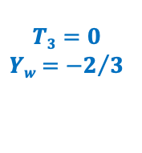


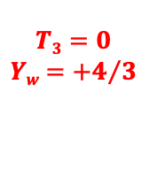
↗︎
Right-Handed Couplings with Pro-Noether cores.
$$T3=0$$ $Yw$ $=0$
$$T3=0$$ $Yw$ $={−2}/3$
$$ν_{e}^{R}$$
$$ν_{μ}^{R}$$
$$d_{ }^{R}$$
$$ν_{ τ}^{R}$$
$$s_{ }^{R}$$
+
−
$$b_{ }^{R}$$
+
↗︎
−
+
−
+
−
+
−
+
↗︎
−
+
↗︎
−
$$T3=0$$ $Yw$ $={+4}/3$
−
−
3/3
+
+
4/2
2/4
$$u_{ }^{R}$$
$$c_{ }^{R}$$
+
−
−
+
$$t_{ }^{R}$$
−
↗︎
−
+
↗︎
+
−
−
5/1
1/5
+
+
−
−
+
+
+
+
$$T3=0$$ $Yw$ $=−2$
$$e_{ }^{R}$$
$$μ_{ }^{R}$$
$$τ_{ }^{R}$$
−
↗︎
−
6/0
−
+
0/6
+
↗︎
+
−
−
+
+
−
−

Slide 9

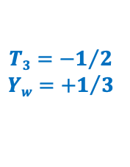



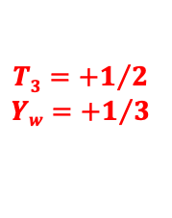





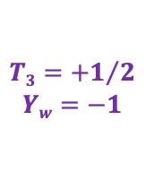



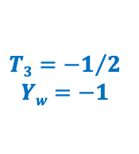
↖︎
Left-Handed Couplings with Pro-Noether cores.
$$T3={+1}/2$$ $Yw$ $=−1$
$$ν_{e}^{L}$$
$$T3={−1}/2$$ $Yw$ $={+1}/3$
$$ν_{μ}^{L}$$
$$ν_{ τ}^{L}$$
$$d_{ }^{L}$$
+
−
$$s_{ }^{L}$$
+
↖︎
−
$$b_{ }^{L}$$
+
−
+
−
+
−
+
↖︎
−
+
↖︎
−
−
−
3/3
+
+
$$T3={+1}/2$$ $Yw$ $={+1}/3$
4/2
2/4
$$u_{ }^{L}$$
+
−
$$c_{ }^{L}$$
−
+
$$t_{ }^{L}$$
−
↖︎
−
+
↖︎
+
−
−
5/1
1/5
+
+
−
−
+
+
+
+
$$T3={−1}/2$$ $Yw$ $=−1$
$$e_{ }^{L}$$
$$μ_{ }^{L}$$
$$τ_{ }^{L}$$
−
↖︎
−
6/0
−
+
0/6
+
↖︎
+
−
−
+
+
−
−

Slide 10


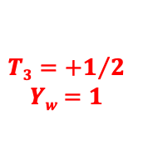





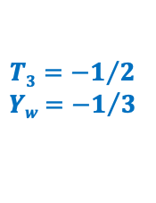






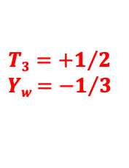
↘︎
Right Handed Couplings with Anti-Noether cores.
$$unable to distinguish$$
$${\overline{ν}}_{e}^{R}$$
$$T3={+1}/2$$ $Yw$ $={−1}/3$
$${\overline{ν}}_{μ}^{R}$$
$${\overline{ν}}_{τ}^{R}$$
$${\overline{d}}_{ }^{R}$$
+
−
$${\overline{s}}_{ }^{R}$$
+
↘︎
−
$${\overline{b}}_{ }^{R}$$
+
−
+
−
+
−
+
↘︎
−
+
↘︎
−
−
−
3/3
+
+
$$T3={−1}/2$$ $Yw$ $={−1}/3$
4/2
2/4
$${\overline{u}}_{ }^{R}$$
$${\overline{c}}_{ }^{R}$$
$${\overline{t}}_{ }^{R}$$
+
−
−
+
−
↘︎
−
+
↘︎
+
−
−
5/1
1/5
+
+
−
−
+
+
+
−
↘︎
−
6/0
−
+
+
0/6
+
↘︎
+
$${\overline{τ}}_{ }^{R}$$
$${\overline{μ}}_{ }^{R}$$
$${\overline{e}}_{ }^{R}$$
$$T3={+1}/2$$ $Yw$ $=1$
−
−
−
+
+
−

Slide 11

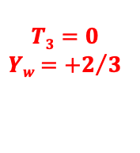












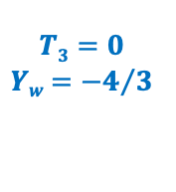
↙︎
Left Handed Couplings with Anti-Noether cores.
$$unable to distinguish$$
$${\overline{ν}}_{e}^{L}$$
$${\overline{ν}}_{μ}^{L}$$
$$T3=0$$ $Yw$ $={+2}/3$
$${\overline{ν}}_{τ}^{L}$$
+
−
$${\overline{d}}_{ }^{L}$$
+
↙︎
−
$${\overline{s}}_{ }^{L}$$
+
−
+
−
$${\overline{b}}_{ }^{L}$$
+
−
+
↙︎
−
$$T3=0$$ $Yw$ $={−4}/3$
+
↙︎
−
−
−
3/3
+
+
$${\overline{u}}_{ }^{L}$$
4/2
2/4
$${\overline{c}}_{ }^{L}$$
$${\overline{t}}_{ }^{L}$$
+
−
−
+
−
↙︎
−
+
↙︎
+
−
−
5/1
1/5
+
+
−
−
+
+
+
−
↙︎
−
6/0
+
0/6
+
↙︎
+
$${\overline{τ}}_{ }^{L}$$
$${\overline{μ}}_{ }^{L}$$
$${\overline{e}}_{ }^{L}$$
$$T3=0$$ $Yw$ $=2$
−
−
+
−
−
+
+
−

Slide 12
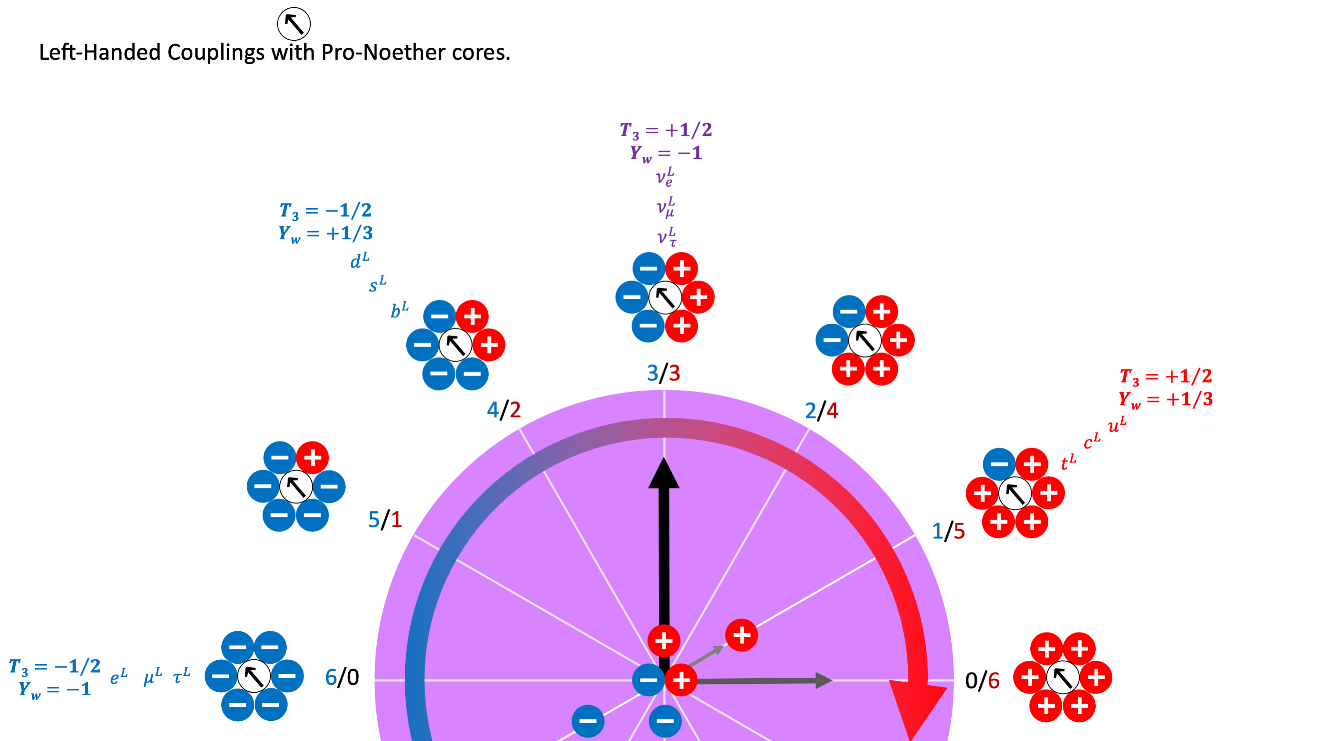
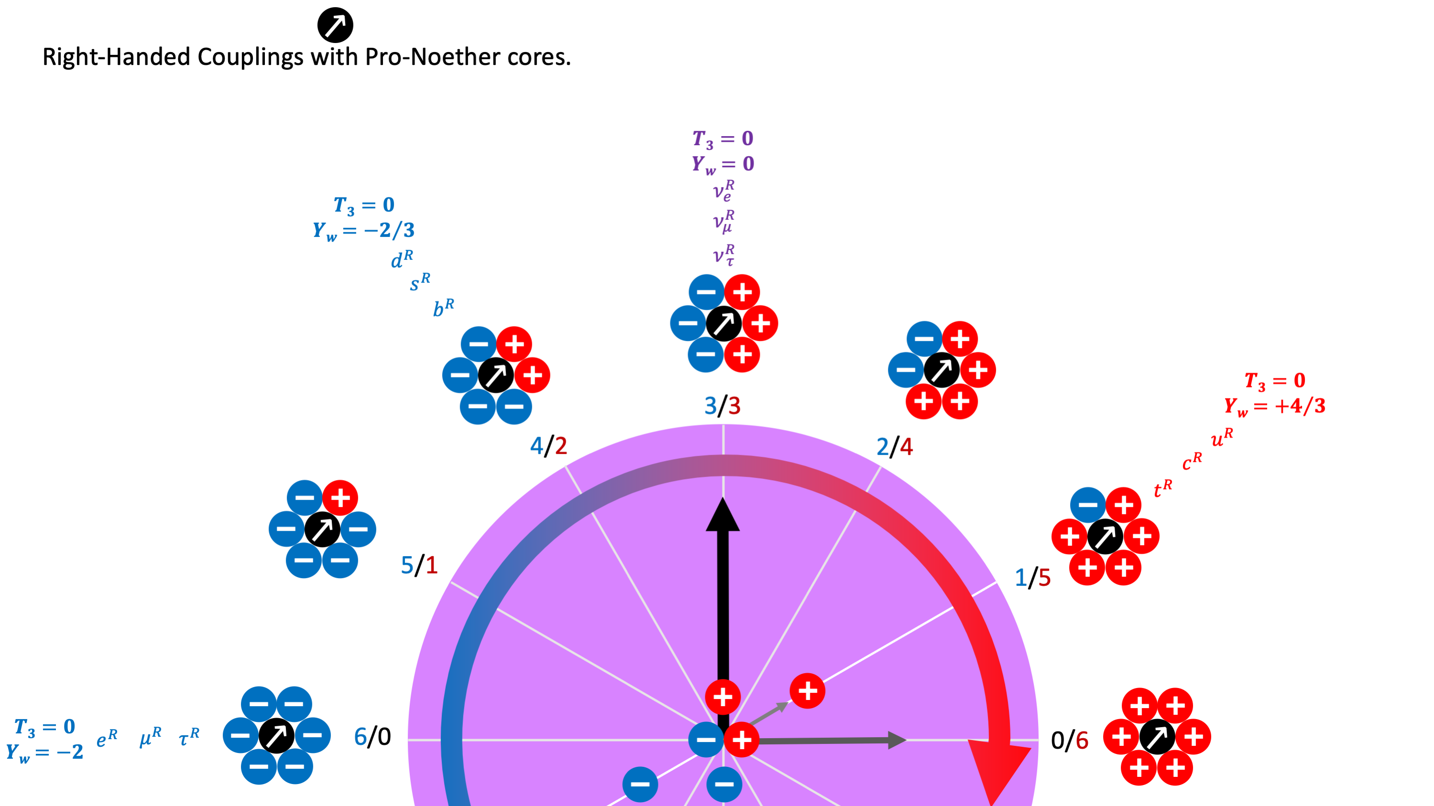
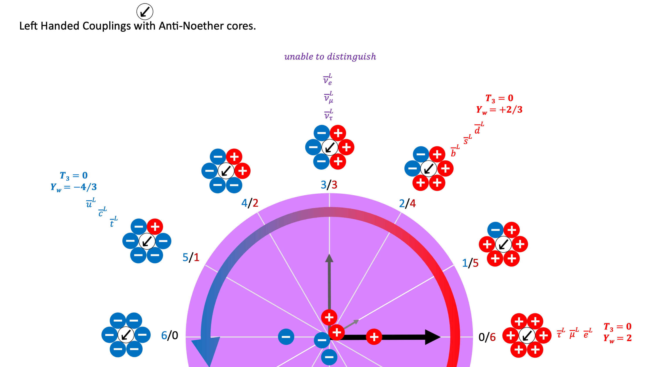
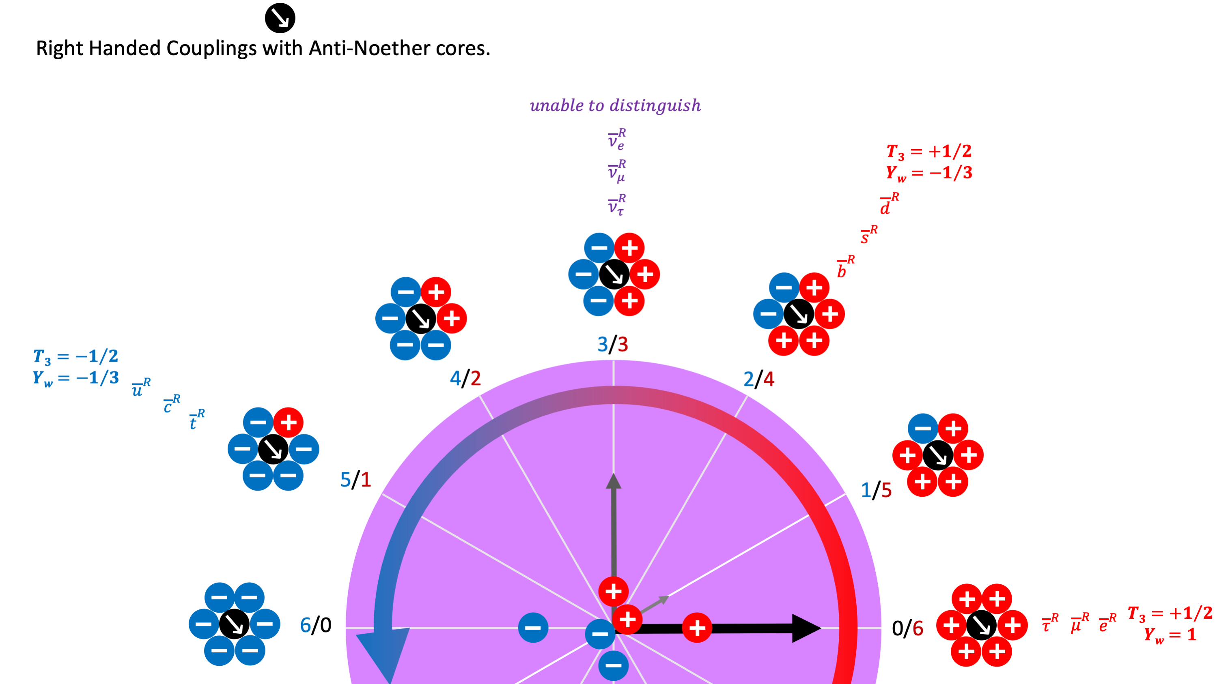

Slide 13
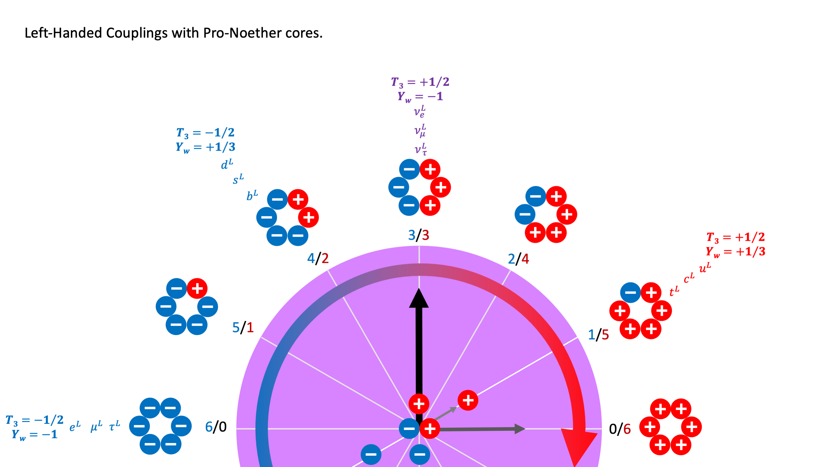

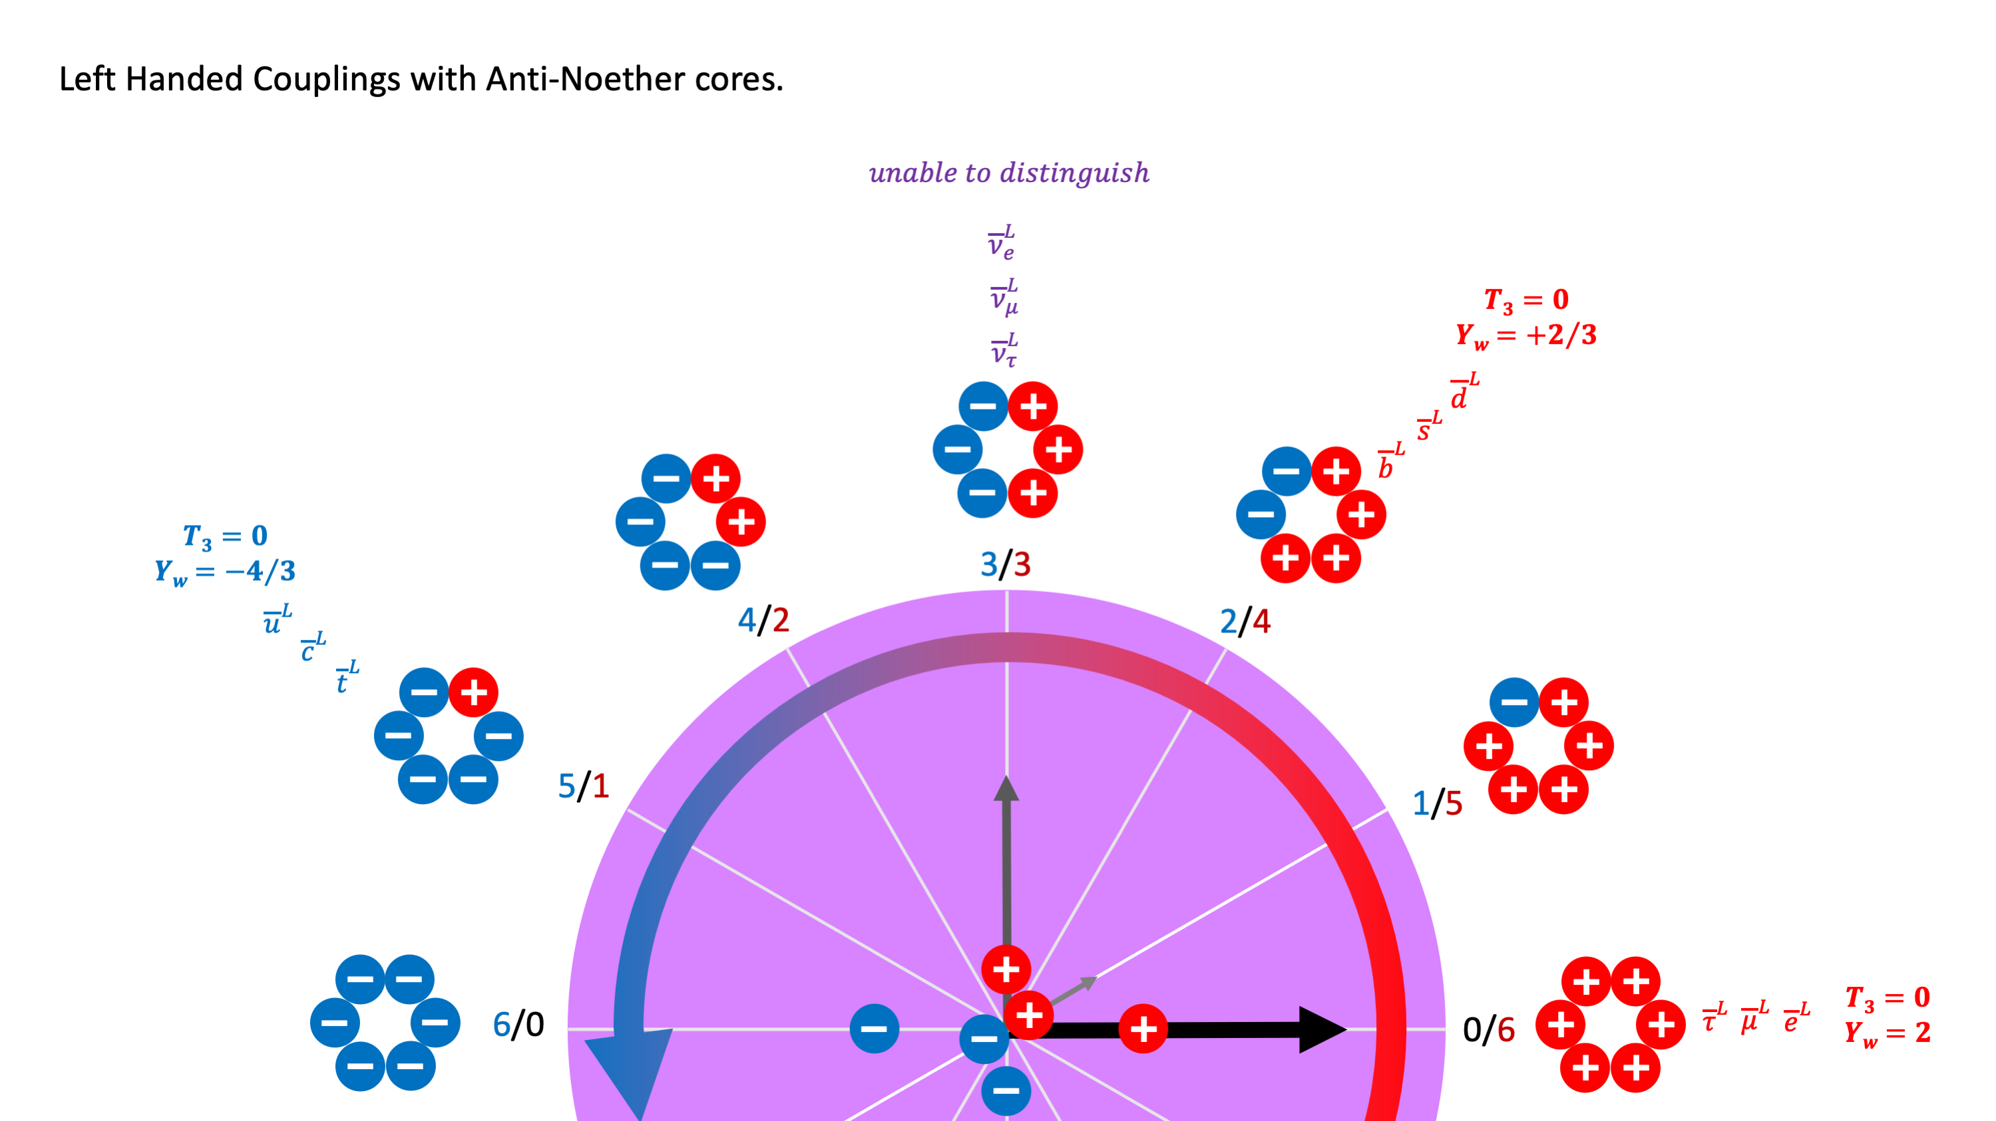
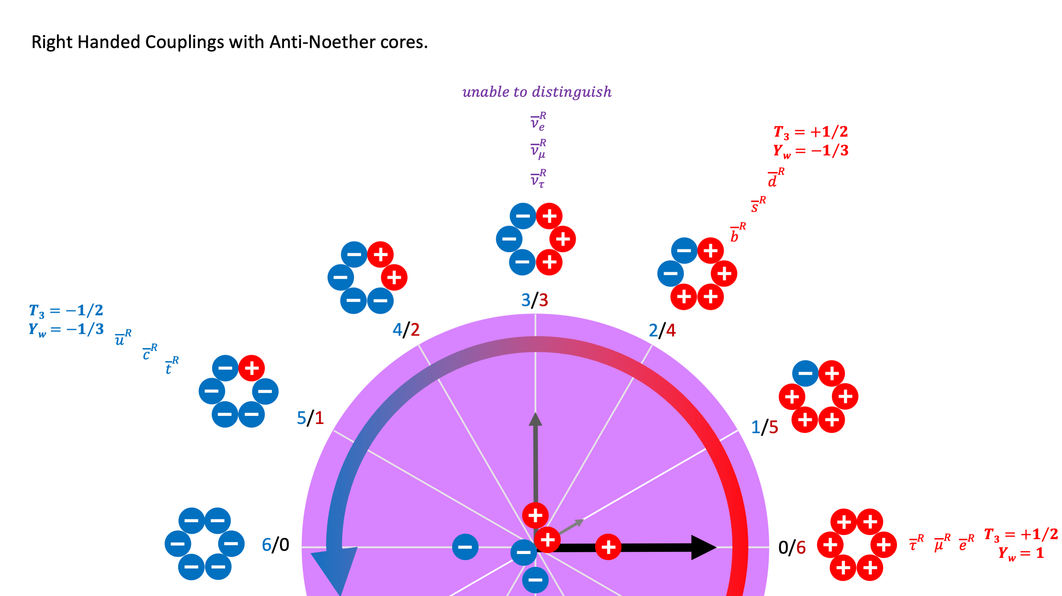

Slide 14
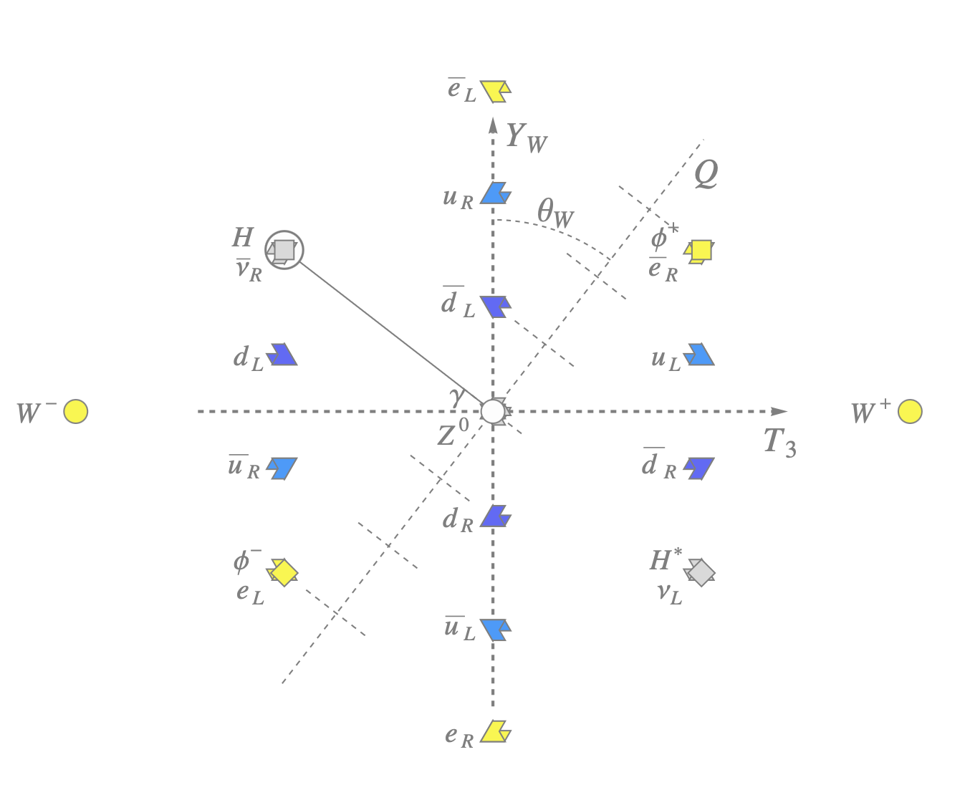
+
+
+
↙︎
+
+
+
−
+
+
−
+
↗︎
+
+
+
+
↘︎
−
+
+
+
↘︎
+
+
−
+
+
+
−
+
−
+
↙︎
−
−
+
+
↖︎
−
+
+
+
↖︎
+
−
−
+
+
+
−
−
↘︎
−
+
−
−
−
+
−
+
↗︎
−
+
↘︎
−
−
−
−
−
+
+
−
↖︎
−
+
−
−
−
+
−
−
↙︎
−
+
↖︎
−
−
−
+
−
−
−
−
↗︎
−
−
−

Slide 15
Nature and the Universe: A Neoclassical Dynamical Geometry of Point Potentials
Bosons and exotic assemblies. Emission superposition = wave equation. → | “Dark Photon” emissions from black hole surface and jets. Extremely shielded, coupled, Noether cores, geometry like a photon? No Big Bang |  | Photon Contra rotating planar pro and anti Noether cores with variable |v| perceived as “c” inside spacetime |  | Ws and Z Ephemeral quasi assemblies in transmutation reactions | Exotics Mesons, etc. See PDG.
Fermion assemblies with six personality potentials in poles (weak force mapping). Emission superposition = wave equation. → | Up quark family Bi-binary nucleus = Gen II Binary nucleus = Gen III |  | Down quark family Bi-binary nucleus = Gen II Binary nucleus = Gen III |  | Electron family Bi-binary nucleus = Gen II Binary nucleus = Gen III | Neutrino family → “Gen II, III”
Einstein’s spacetime assemblies. Nestled Noether cores (two pro, two anti). Deformable with spacetime energy gradient (from excitation by mass) or from group velocity, oblateness maps to Einstein’s variable time, inflates/expands with decreasing energy, contracts/deflates with increasing energy. Maps to pair production, annihilation, quantum vacuum
Tri binary Noether core: Binary capture, stable in R4, high shielding by superposition, nucleus gen I fermion, (L/R) spin ½ orbital angular momentum vectors precession, moments Full orthogonal 3D configuration corresponds to Fermi Dirac statistics. Becomes oblate with nearby mass or with velocity. Planar at group |v| = @ with Bose-Einstein statistics. Pro and anti configurations, Basis of all stable standard model particle assemblies: Gen I fermions, photons, W/Z bosons, Higgs/Graviton spacetime assemblies. Noether cores are the source of what science perceives as dark matter/energy.
Bi binary Noether core: Binary capture, unstable/reactive in R4, medium shielding by superposition, nucleus gen II fermion
Isolated binary Noether core: unstable/reactive in R4, low shielding by superposition, nucleus gen III fermion
AdS regime binary with |v| > @ Partner and self action, inflation, deflation |  | Symmetry breaking point binary with |v| = @ Partner action, Planck scale | |v| = @ Partner action Symmetry Breaking Point Planck scale | CFT regime binary with |v| < @ Partner action, expansion, contraction
Primal Assembly – The Point Potential Binary Scalable over many orders of magnitude, asymptotic safety: minimum radius, maximums in velocity, curvature, energy, and frequency. couplings of axial vortices map to strong force, 1Hz change = the quantum of angular momentum
Point Potentials Geometric points (r=0), constant rate potential emitters, spherical emissions with field speed @, no fundamental speed limit, electrino = -|e/6|, positrino = +|e/6|, no known genesis, immutable, continuous path history, large scale empirical constants: 50/50 population, density₁ point potentials per volume, density₂ point potential energy per volume
Absolute time 1D, linear, forward moving, no known beginning or end.
Absolute space 3D, Euclidean, continuous, no known beginning or end.

Slide 16
Thank You
Questions?

Slide 17
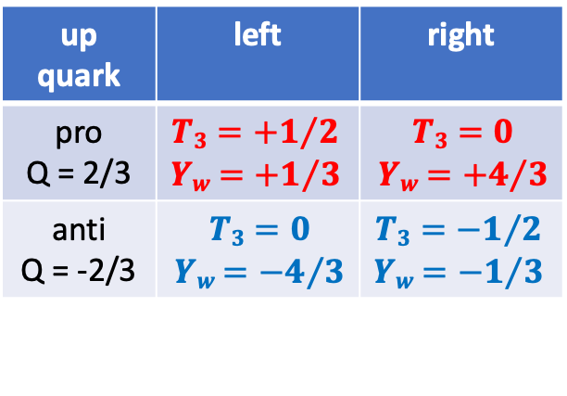
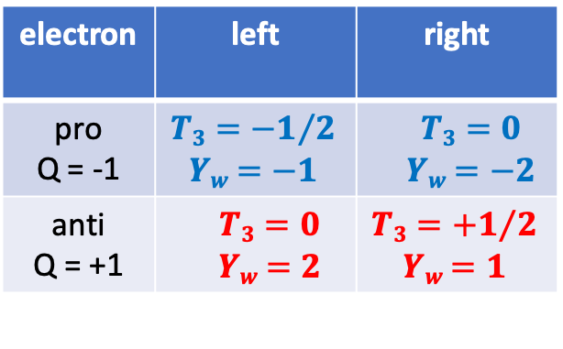
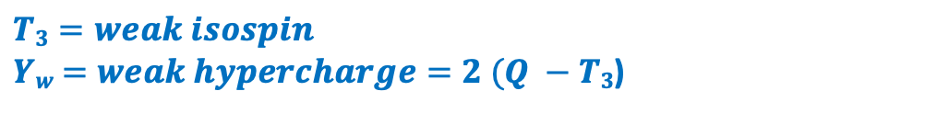
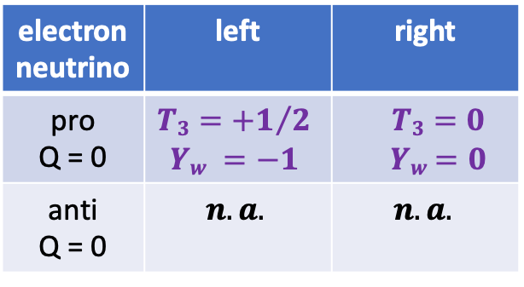
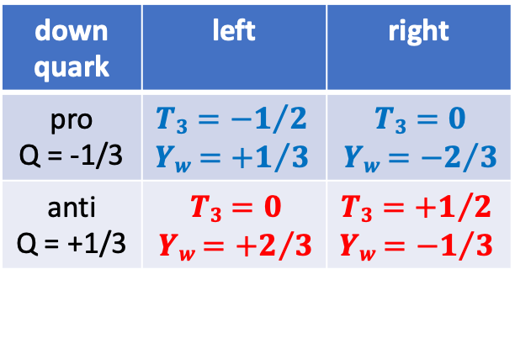
electron | left | right
pro Q = -1 | $$T3={−1}/2$$ $Yw$ $=−1$ | $$T3=0$$ $Yw$ $=−2$
anti Q = +1 | $$T3=0$$ $Yw$ $=2$ | $$T3={+1}/2$$ $Yw$ $=1$
up quark | left | right
pro Q = 2/3 | $$T3={+1}/2$$ $Yw$ $={+1}/3$ | $$T3=0$$ $Yw$ $={+4}/3$
anti Q = -2/3 | $$T3=0$$ $Yw$ $={−4}/3$ | $$T3={−1}/2$$ $Yw$ $={−1}/3$
electron neutrino | left | right
pro Q = 0 | $$T3={+1}/2 \\ Yw =−1$$ | $$T3=0$$ $Yw$ $=0$
anti Q = 0 | $$n.a.$$ | $$n.a.$$
down quark | left | right
pro Q = -1/3 | $$T3={−1}/2$$ $Yw$ $={+1}/3$ | $$T3=0$$ $Yw$ $={−2}/3$
anti Q = +1/3 | $$T3=0$$ $Yw$ $={+2}/3$ | $$T3={+1}/2$$ $Yw$ $={−1}/3$
$$T3=weak isospin$$ $Yw$ $=weak hypercharge=2 (Q −T3$)
Weak isospin is a quantum number relating to the weak interaction, and parallels the idea of isospin under the strong interaction. Weak isospin is usually given the symbol T or I, with the third component written as T3 or I3. T3 is more important than T and typically the term "weak isospin" may refer to the "3rd component of weak isospin". Weak interactions conserve T3. It is also conserved by the electromagnetic and strong interactions. However, interaction with the Higgs field does not conserve T3, as directly seen by propagation of fermions, mixing chiralities by dint of their mass terms resulting from their Higgs couplings. Since the Higgs field vacuum expectation value is nonzero, particles interact with this field all the time even in vacuum. Interaction with the Higgs field changes particles' weak isospin (and weak hypercharge). Only a specific combination of them shown in the Yw equation is conserved.
A chiral phenomenon is one that is not identical to its mirror image. The spin of a particle may be used to define a handedness, or helicity, for that particle, which, in the case of a massless particle, is the same as chirality. A symmetry transformation between the two is called parity transformation. The helicity of a particle is positive (“right-handed”) if the direction of its spin is the same as the direction of its motion. It is negative (“left-handed”) if the directions of spin and motion are opposite. Particle physicists have only observed or inferred left-handed fermions and right-handed antifermions engaging in the charged weak interaction. Even in the case of the electrically neutral weak interaction, which can engage with both left- and right-chiral fermions, in most circumstances two left-handed fermions interact more strongly than right-handed or opposite-handed fermions, implying that the universe has a preference for left-handed chirality.

Slide 18
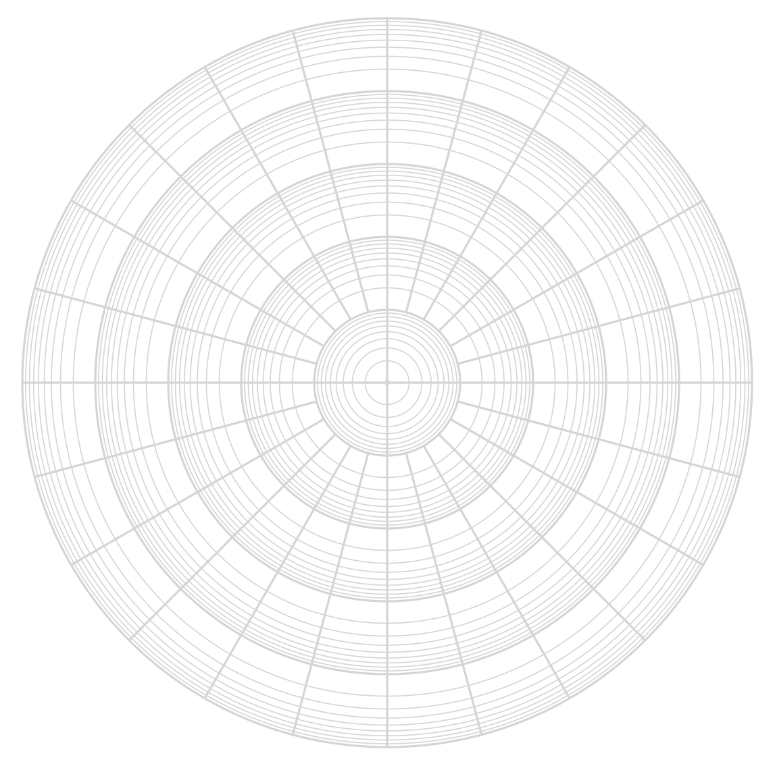
































































Neoclassical Physics and Quantum Gravity
Point Potential Decoding of Standard Model Fermions
$$T3={−1}/2$$ $Yw$ $=−1$
$$T3=0$$ $Yw$ $=−2$
I
$$T3=0$$ $Yw$ $={−4}/3$
$$e_{ }^{L}$$
$$e_{ }^{R}$$
$$T3={−1}/2$$ $Yw$ $={+1}/3$
$${\overline{u}}_{ }^{L}$$
$$μ_{ }^{L}$$
II
$$μ_{ }^{R}$$
$$d_{ }^{L}$$
$${\overline{c}}_{ }^{L}$$
$$τ_{ }^{L}$$
III
$$τ_{ }^{R}$$
$$s_{ }^{L}$$
$${\overline{t}}_{ }^{L}$$
I
$$b_{ }^{L}$$
$$T3={−1}/2$$ $Yw$ $={−1}/3$
$$T3=0$$ $Yw$ $={−2}/3$
$${\overline{u}}_{ }^{R}$$
$$d_{ }^{R}$$
Noether core
A binary is opposite point potentials orbiting each other
A Noether core has 1, 2, or 3 nested binaries.
The binaries are at different energy scales.
Binaries superimpose and shield energy.
Nucleons have 3 Noether cores (3:3+3:3+3:3=9:9)
Protons 9:9 in cores, 6:12 in personality potentials
Neutrons 9:9 in cores, 9:9 in personality potentials
Noether cores come in pro and anti configurations
Noether cores can spin left or right relative to velocity
Personality layer
six point potentials,
all combinations.
$${\overline{c}}_{ }^{R}$$
II
$$s_{ }^{R}$$
$${\overline{t}}_{ }^{R}$$
$$b_{ }^{R}$$
$$T3=0$$ $Yw$ $=0$
$${\overline{γ}}_{ }^{L}$$
$$γ_{ }^{L}$$
III
$$ν_{e}^{R}$$
$$ν_{e}^{L}$$
$$ν_{μ}^{L}$$
$$ν_{μ}^{R}$$
$$T3={+1}/2$$ $Yw$ $=−1$
$$ν_{ τ}^{L}$$
Noether Core
$$ν_{ τ}^{R}$$
$${\overline{ν}}_{μ}^{L}$$
$${\overline{ν}}_{τ}^{L}$$
$${\overline{ν}}_{τ}^{R}$$
$${\overline{ν}}_{μ}^{R}$$
$${\overline{ν}}_{e}^{L}$$
III
$${\overline{ν}}_{e}^{R}$$
$${\overline{γ}}_{ }^{R}$$
$$γ_{ }^{R}$$
$${\overline{b}}_{ }^{L}$$
II
$$t_{ }^{L}$$
$${\overline{s}}_{ }^{L}$$
$$c_{ }^{L}$$
$${\overline{d}}_{ }^{L}$$
$$u_{ }^{L}$$
$$T3={+1}/2$$ $Yw$ $={+1}/3$
$$T3=0$$ $Yw$ $={+2}/3$
I
$${\overline{b}}_{ }^{R}$$
$$t_{ }^{R}$$
$${\overline{s}}_{ }^{R}$$
$${\overline{τ}}_{ }^{L}$$
III
$${\overline{τ}}_{ }^{R}$$
$$c_{ }^{R}$$
electrino -e/6
positrino +e/6
binary
$${\overline{d}}_{ }^{R}$$
$${\overline{μ}}_{ }^{L}$$
II
$${\overline{μ}}_{ }^{R}$$
$$u_{ }^{R}$$
$$T3={+1}/2$$ $Yw$ $={−1}/3$
$${\overline{e}}_{ }^{L}$$
$${\overline{e}}_{ }^{R}$$
$$T3=0$$ $Yw$ $={+4}/3$
I
$$T3=0$$ $Yw$ $=2$
$$T3={+1}/2$$ $Yw$ $=1$

Slide 19
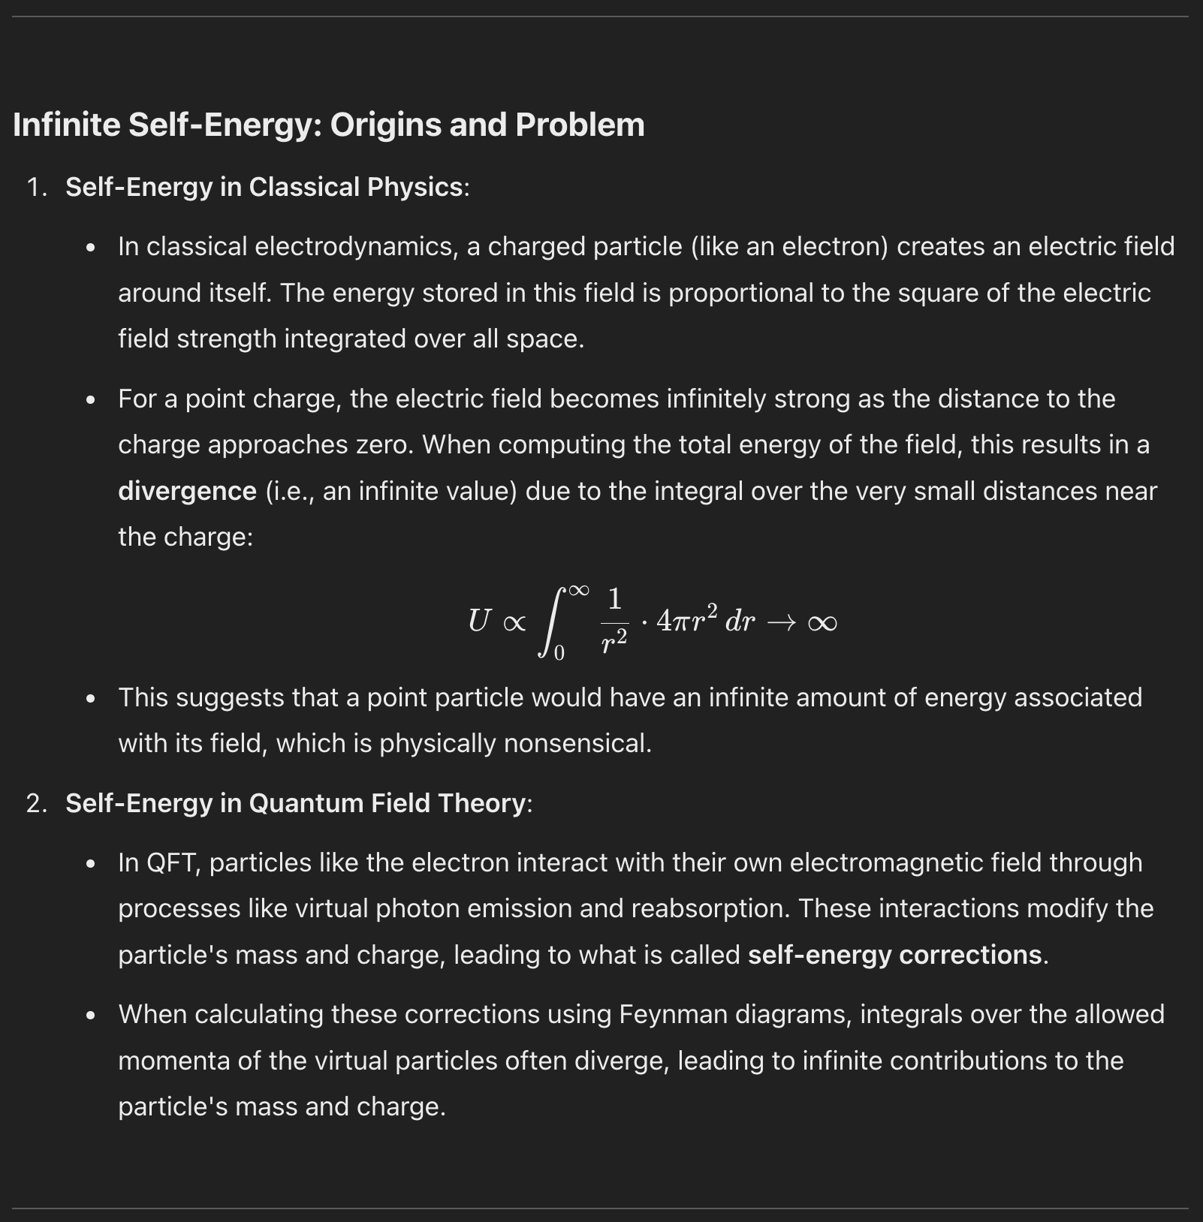
Point charges are confusing and incompletely modeled.
Instead, consider a point object which
emit potential at a constant rate
act in response to received potential (superposition)
are modeled as a Dirac delta at r=0 and q/r otherwise.
There are multiple ways the old concerns don’t matter.
there is only one case where the 1/r path is followed and that is the spiraling binary, which has a limit.
architrinos move through potential fields at ease
everything is superposition, relax
The self energy issues are a result of an ontology too far from base nature.
J Mark Morris
architrino.com

Slide 20
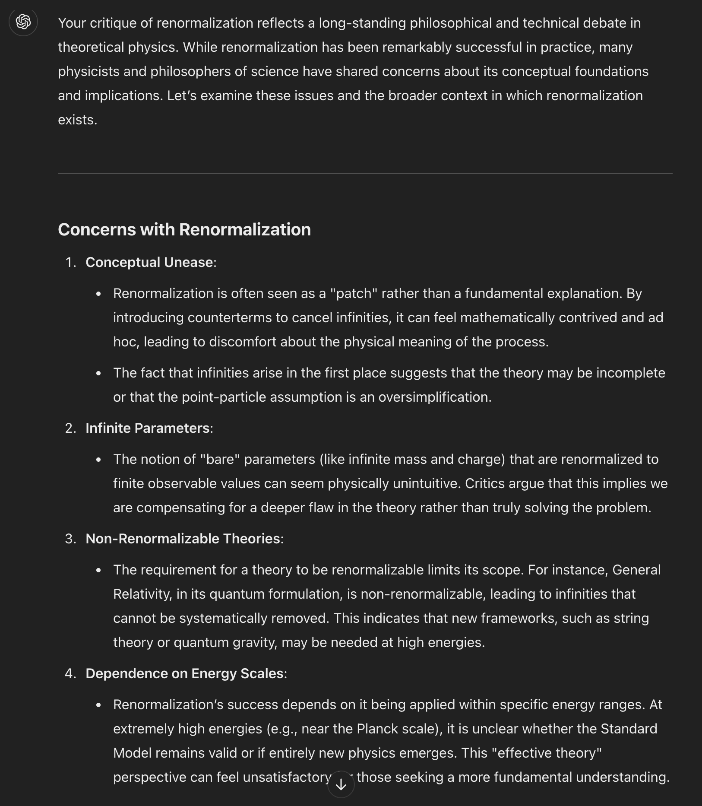
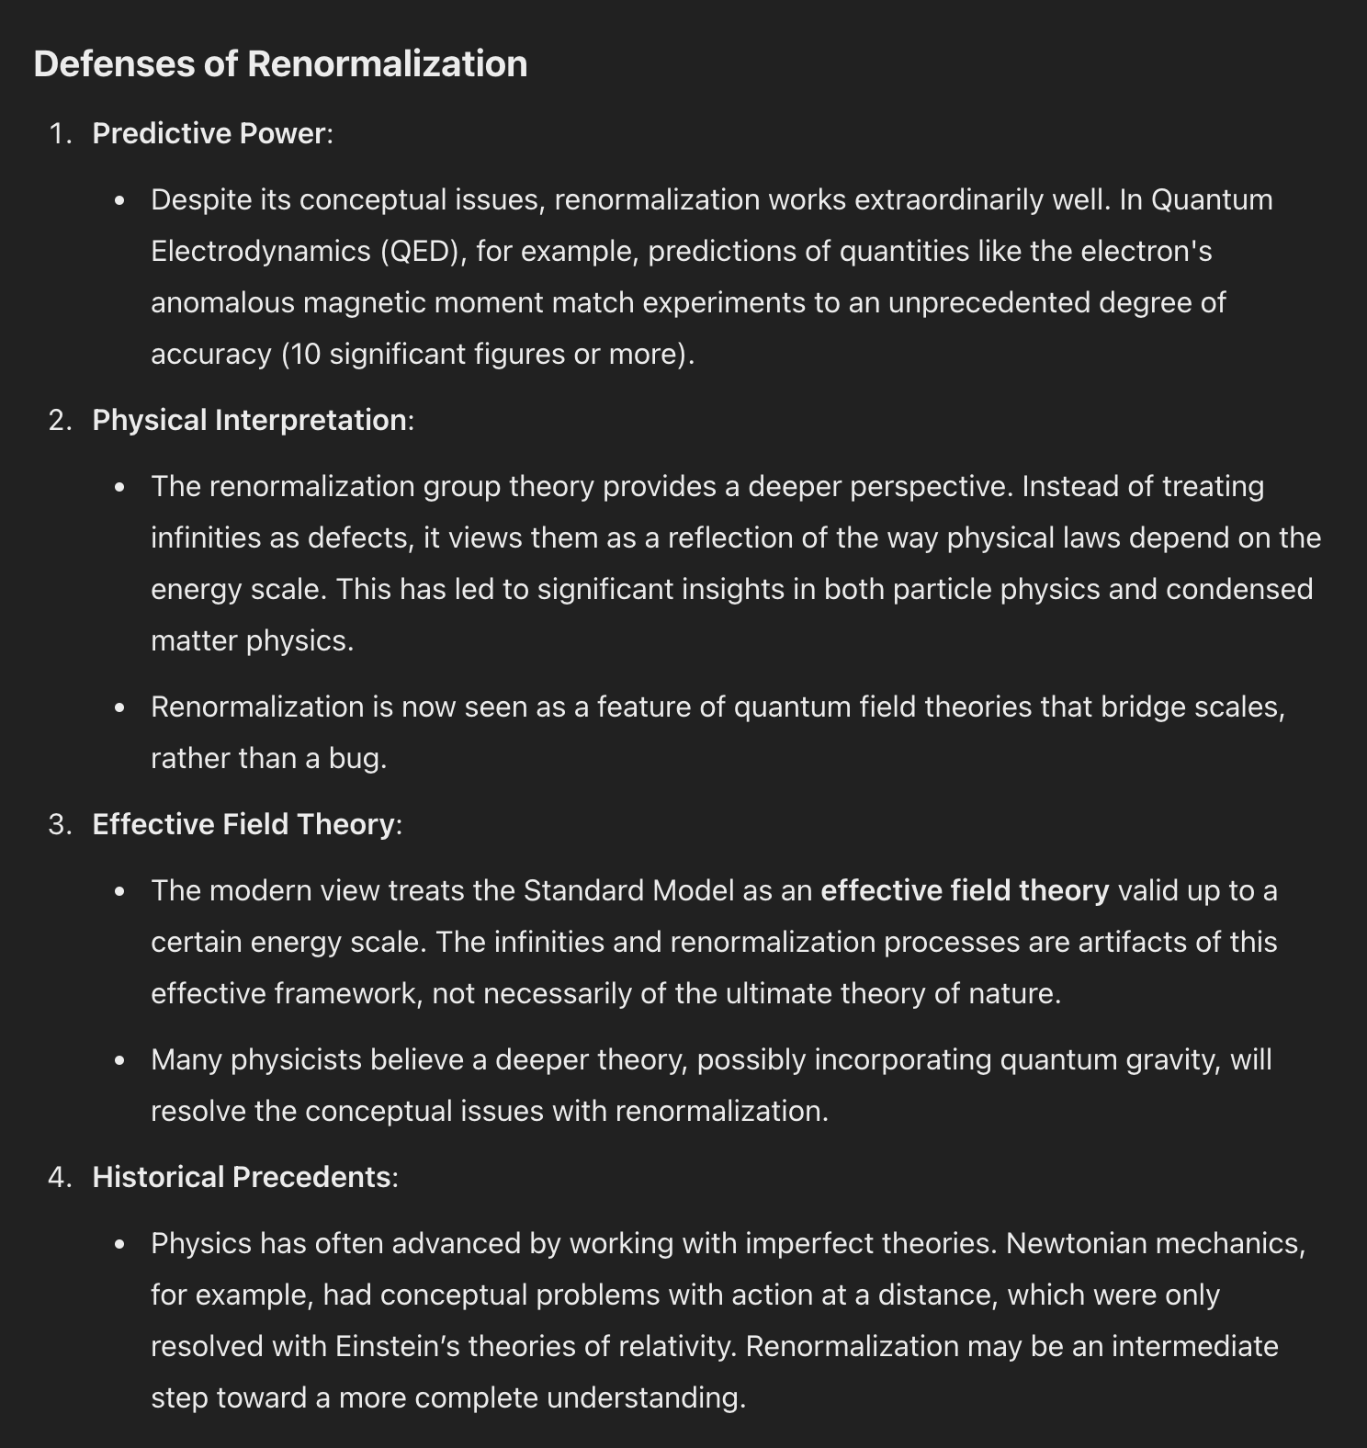
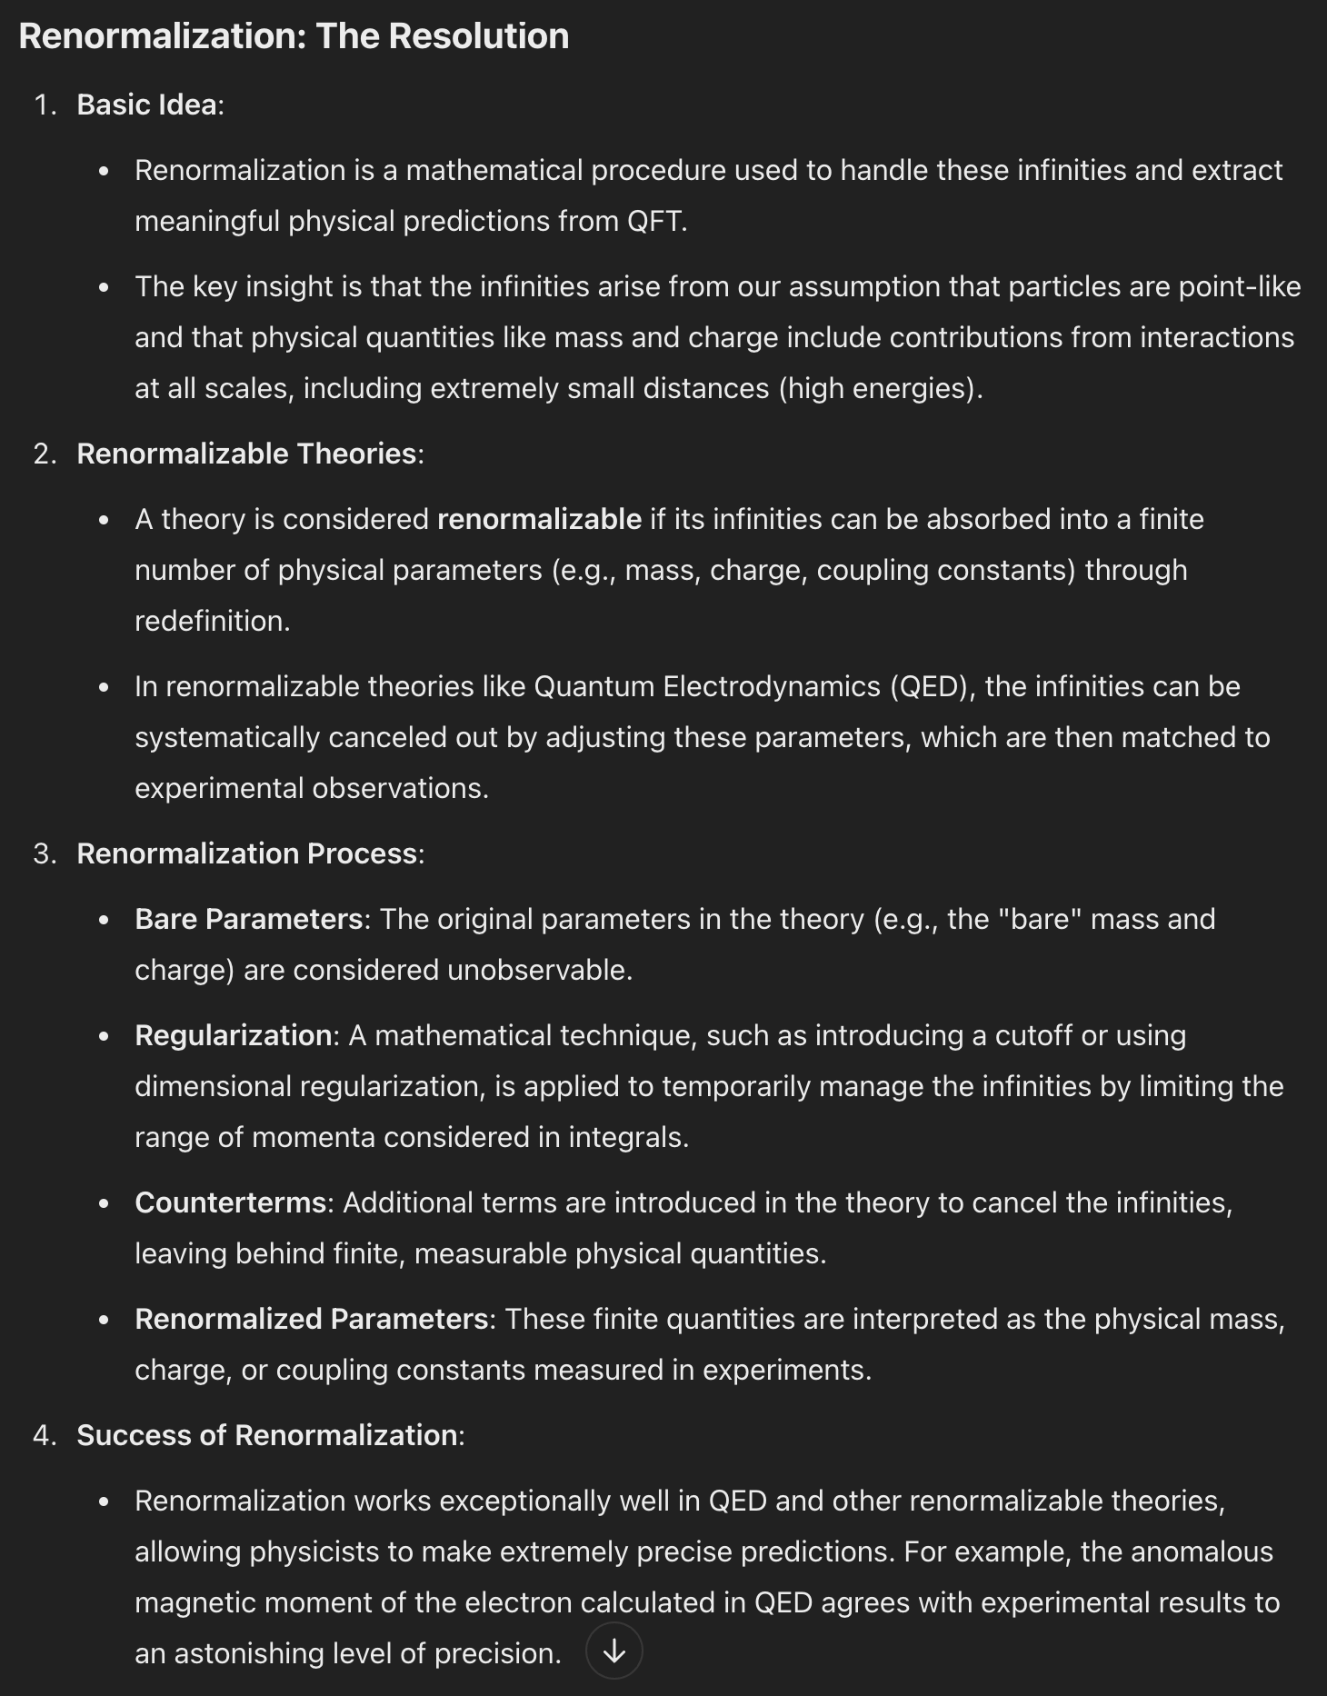
Seriously?
They gave up because of this issue?
And they had superposition?
And they knew about frequencies.
And had already considered orbits.
And knew about path history for point charges.
It boggles my mind how major challenges and paradox are considered as perplexing oddities to be ignored and yet we put on the blinders and use proxies like renormalization in the theories.
Are you kidding me?
J Mark Morris
architrino.com

